Slide 1
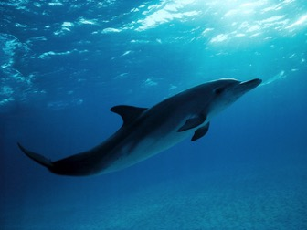
Dolphins: Life at Sea
An interactive lesson on the relationship of life in the ocean.
Dylan Czarnecki

Slide 2
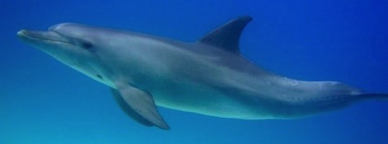
What is in this lesson:
Facts about the ocean
Facts about dolphins
How dolphins fit in with other ocean life
Links and games

Slide 3
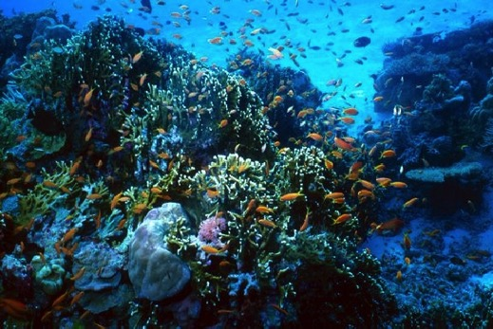
Ocean Facts
They are made up of salt water
Oceans cover 70% of the Earth
They help make the air that we breathe
The oceans are home to many animals and plants

Slide 4
Dolphin Facts
Dolphins are mammals that live in the ocean
Dolphins eat fish
Dolphins live in groups called a pod
Dolphins breathe through a blowhole on top of their head.
Watch the dolphins surface to breathe!

Slide 5
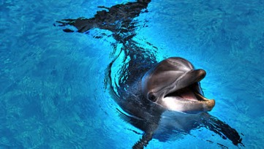
More Dolphin Facts
Dolphins use echolocation, which is sound that they use to find food, talk to each other, and find their way.
There are many different kinds of dolphins found all over the world.
Dolphins are very fast swimmers, they can even swim as fast as some boats!
Click the speaker to hear the sound a dolphin makes!

Slide 6
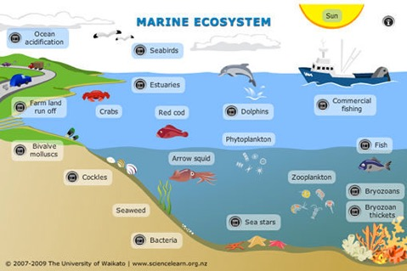
How Dolphins Are a Part of the Ocean
Every animal is part of the environment they live in. This is called an ecosystem and groups of similar ecosystems are called biomes. Dolphins live in ocean biome, or marine biome. The fish they eat feed on ocean plants and smaller fish. Those plants and fish eat even smaller plants and animals. This is called a food chain. A food chain is important because it keeps the ecosystem balanced. If an ecosystem is balanced, then all of the plants and animals are healthy.

Slide 7
Investigation
With your parents, use the links on the next page to answer these questions:
What do dolphins use their teeth for?
What are some other animals that live in the ocean with dolphins?
Are there different kinds of biomes? What are they?

Slide 8
Helpful Links
kidsdiscover.com/spotlight/biomes-for-kids/
greatbarrierreef.com.au/animals/fish/
dolphins.org/kids_dolphin_facts

